Slide 1
Network DEA in Insurance Industry
吳延東

Slide 2
現行問題
Scale efficiency in two-stage network DEA
Efficiency decomposition of the network DEA in variable returns to scale: an additive dissection in losses
Revised model

Slide 3
現行問題
Scale efficiency in two-stage network DEA
Efficiency decomposition of the network DEA in variable returns to scale: an additive dissection in losses
Revised model

Slide 4
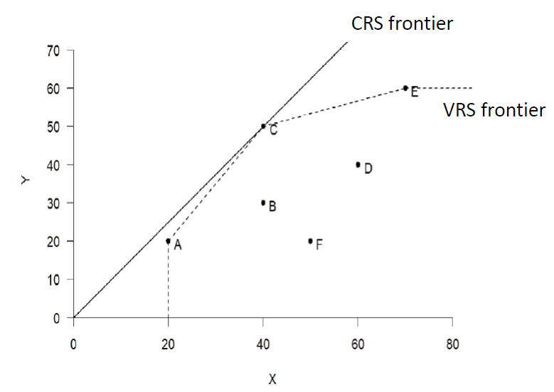
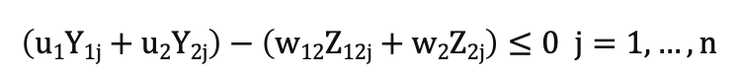
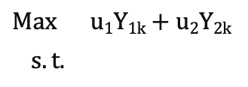
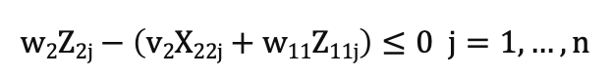
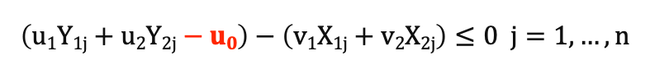
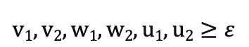
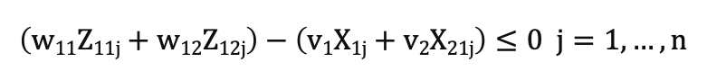
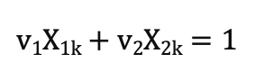
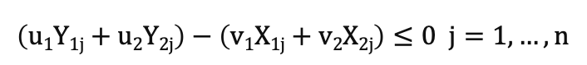
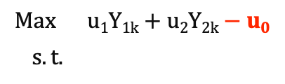
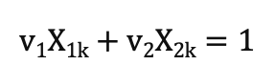
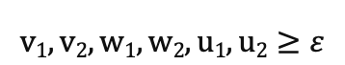
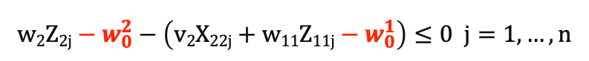
現行問題
CRS
Property of DEA:
Technical efficiency ≥ Overall efficiency
$$Max u1Y1k+u2Y2k$$
$s.t.$
$$v1X1k+v2X2k=1$$
$$\left(u1Y1j+u2Y2j\right)−\left(v1X1j+v2X2j\right)≤0 j=1,…,n$$
$$\left(w11Z11j+w12Z12j\right)−\left(v1X1j+v2X21j\right)≤0 j=1,…,n$$
$$w2Z2j−\left(v2X22j+w11Z11j\right)≤0 j=1,…,n$$
$$\left(u1Y1j+u2Y2j\right)−\left(w12Z12j+w2Z2j\right)≤0 j=1,…,n$$
$$v1, v2, w1, w2, u1, u2≥ε$$
VRS
$$Max u1Y1k+u2Y2k−u0$$
$s.t.$
$$v1X1k+v2X2k=1$$
$$\left(u1Y1j+u2Y2j−u0\right)−\left(v1X1j+v2X2j\right)≤0 j=1,…,n$$
$$\left(w11Z11j+w12Z12j−w_{0}^{1}\right)−\left(v1X1j+v2X21j\right)≤0 j=1,…,n$$
$$w2Z2j−w_{0}^{2}−\left(v2X22j+w11Z11j−w_{0}^{1}\right)≤0 j=1,…,n$$
$$\left(u1Y1j+u2Y2j−u0\right)−\left(w12Z12j−w_{0}^{1}+w2Z2j−w_{0}^{2}\right)≤0 j=1,…,n$$
$$v1, v2, w1, w2, u1, u2≥ε$$

Slide 5
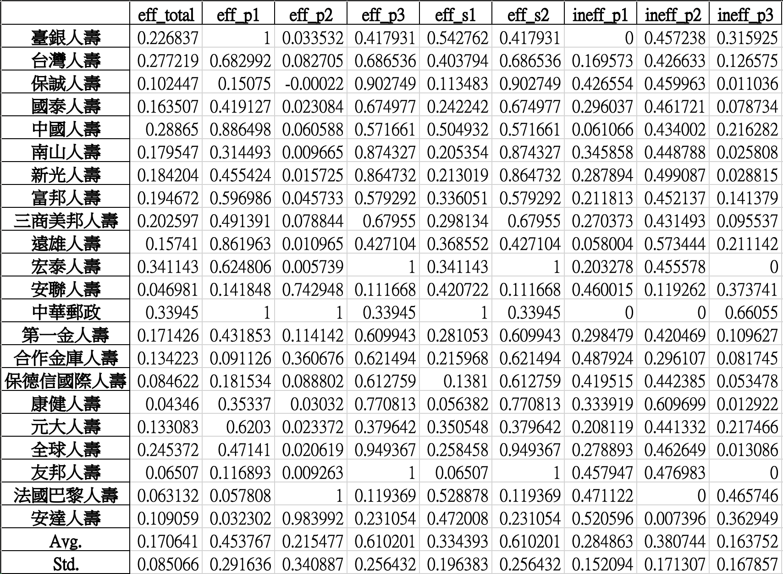
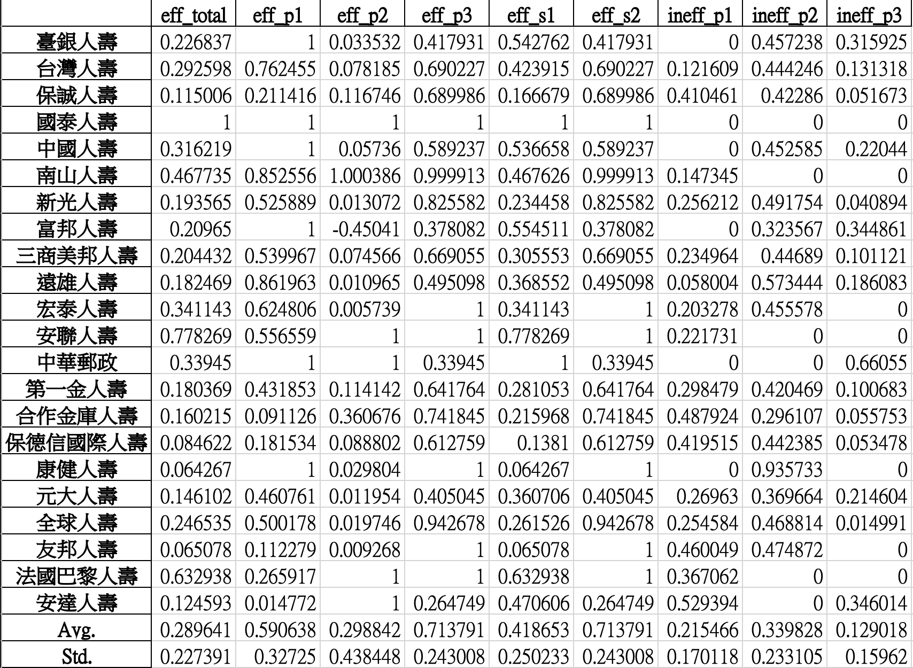
Property of DEA:
Technical efficiency ≥ Overall efficiency
現行問題
CRS
VRS
在解讀各 process 的效率值會受到 free variable 影響
以致於難以解讀

Slide 6
現行問題
Scale efficiency in two-stage network DEA
Efficiency decomposition of the network DEA in variable returns to scale: an additive dissection in losses
Revised model

Slide 7
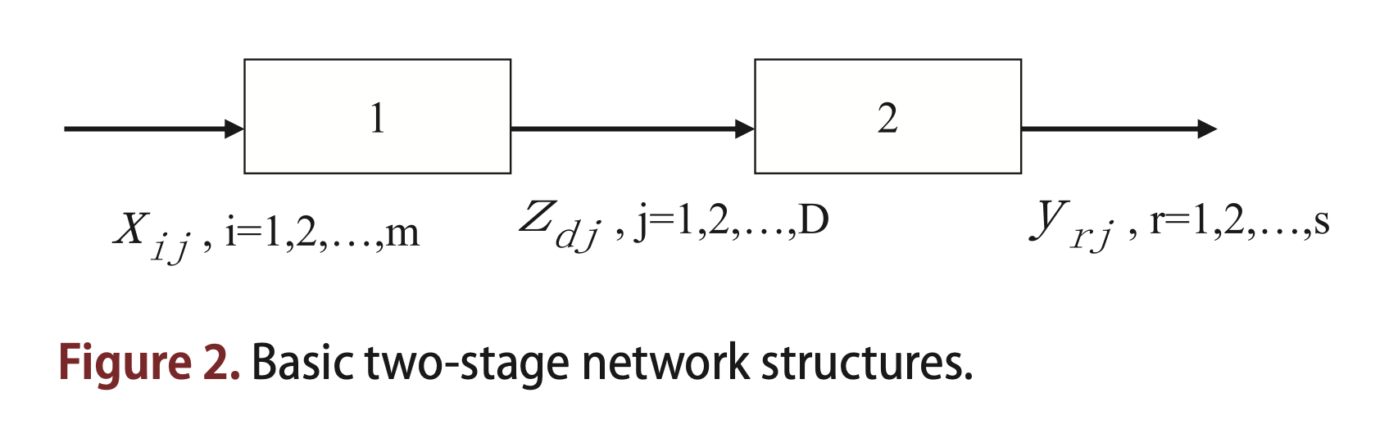
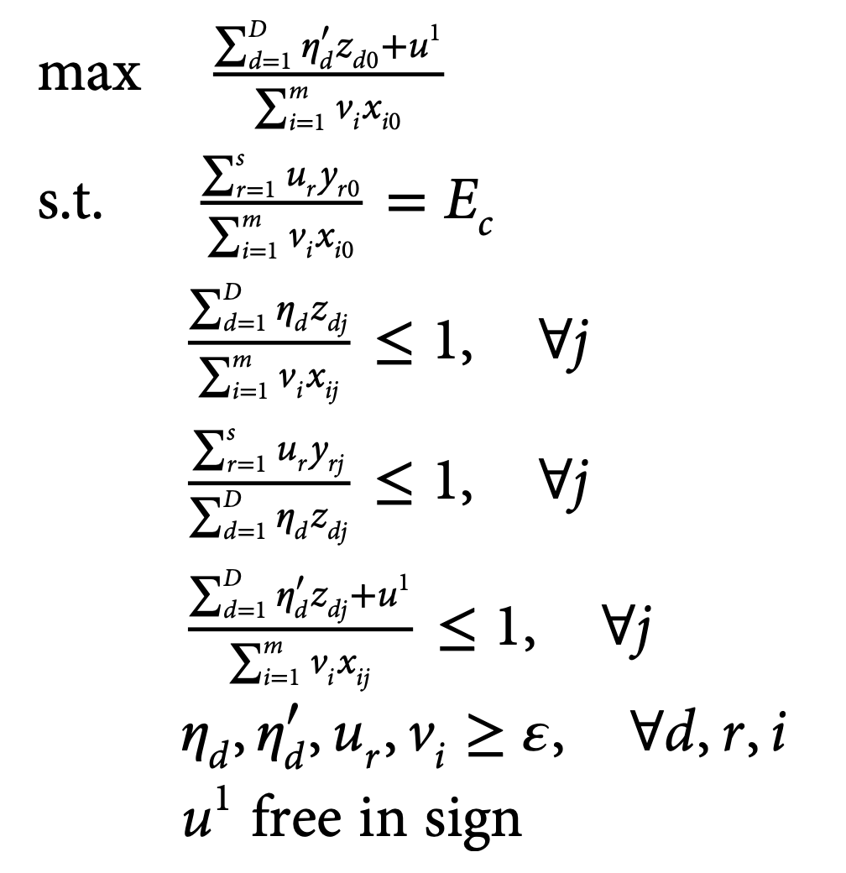
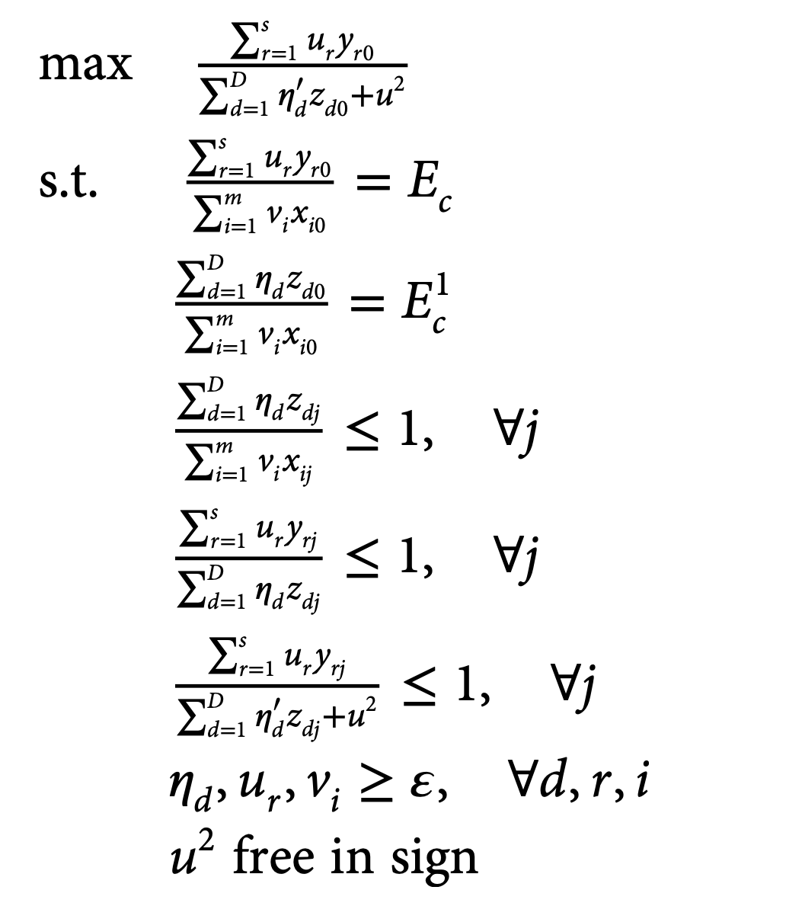
Scale efficiency in two-stage network DEA
Kao and Hwang (2011) suggest to utilize the input-oriented VRS model to compute technical efficiency of the first stage and the output-oriented VRS model to measure technical efficiency of the second stage.
first stage
second stage

Slide 8
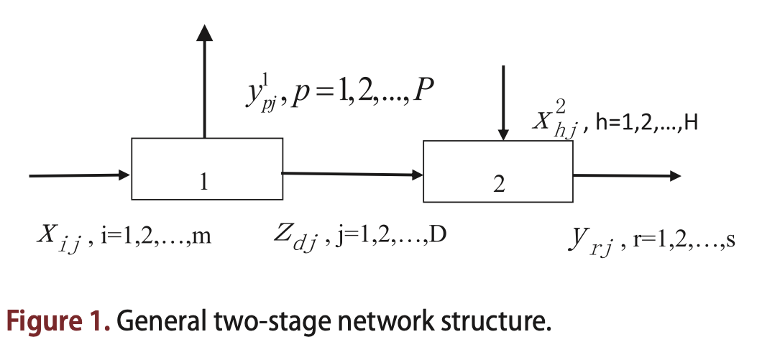
Scale efficiency in two-stage network DEA
Kao and Hwang (2011) suggest to utilize the input-oriented VRS model to compute technical efficiency of the first stage and the output-oriented VRS model to measure technical efficiency of the second stage.
first stage
second stage
η_{d} can have different optimal values in models (5) and (6) due to the fact that the two models are solved independently.

Slide 9
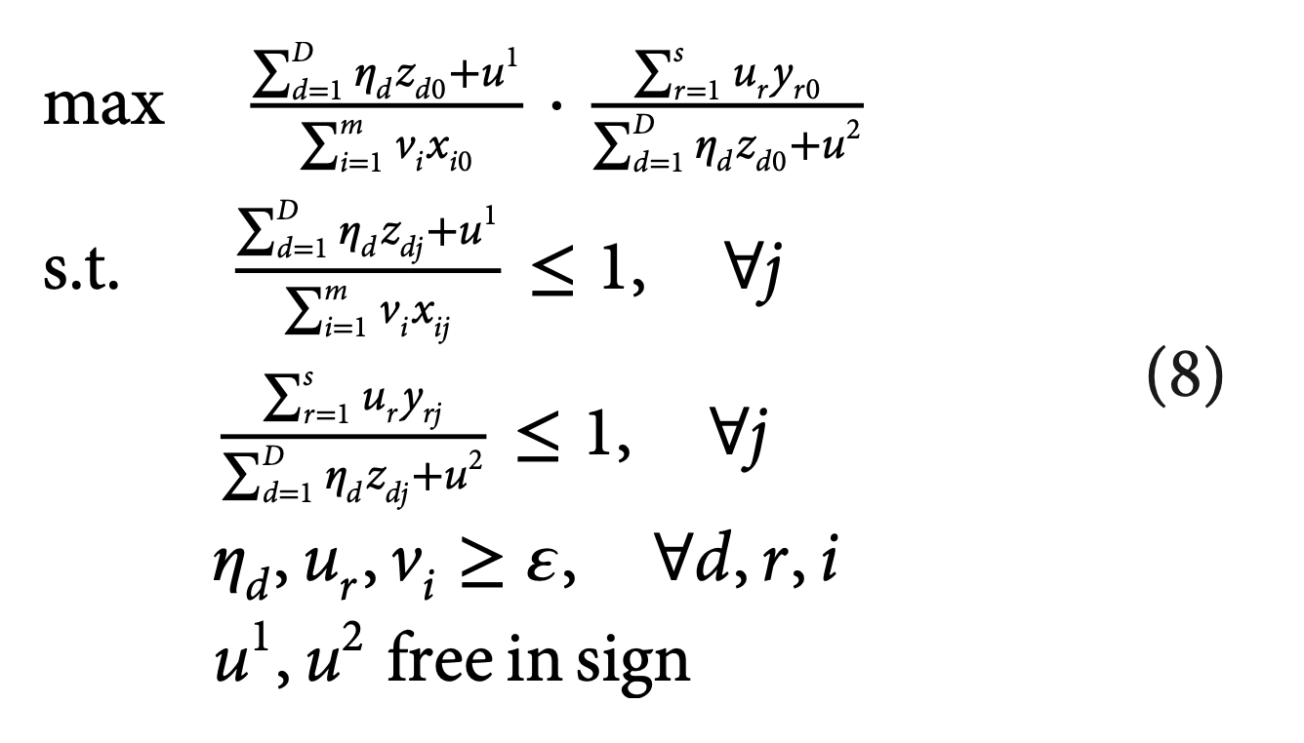
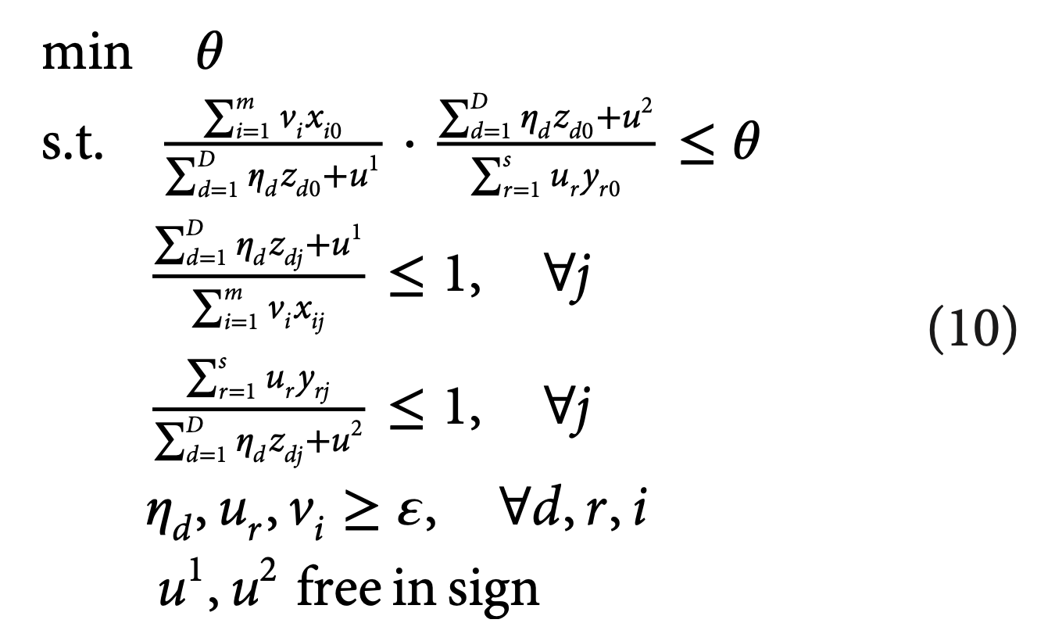
Scale efficiency in two-stage network DEA

Slide 10
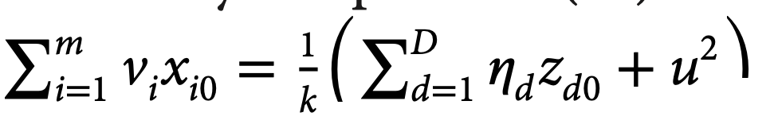
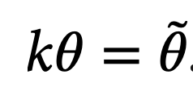
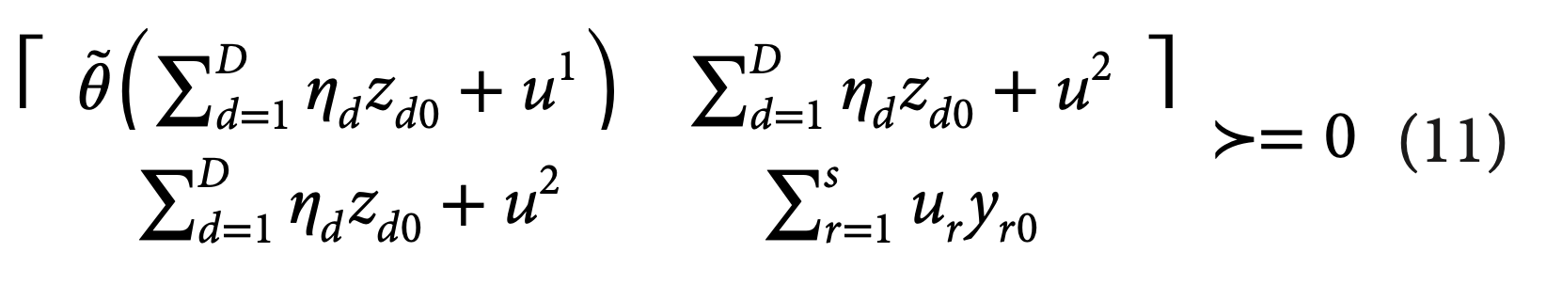
Scale efficiency in two-stage network DEA
假設：

Slide 11
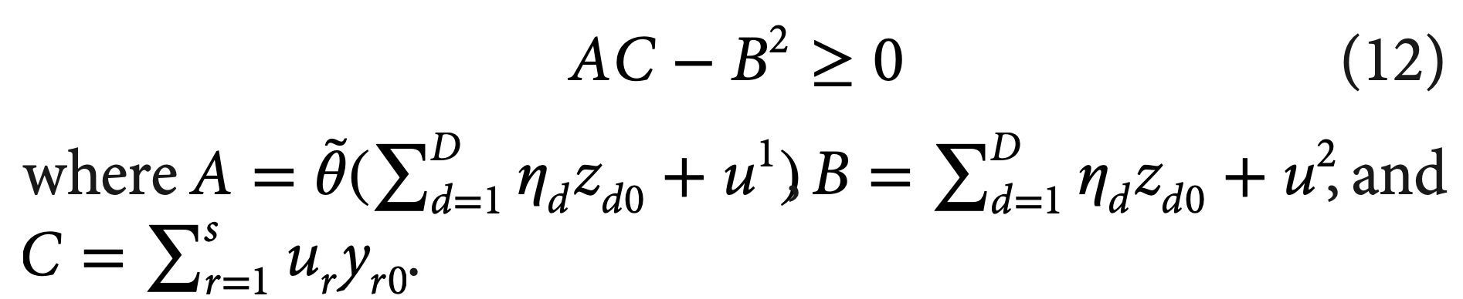
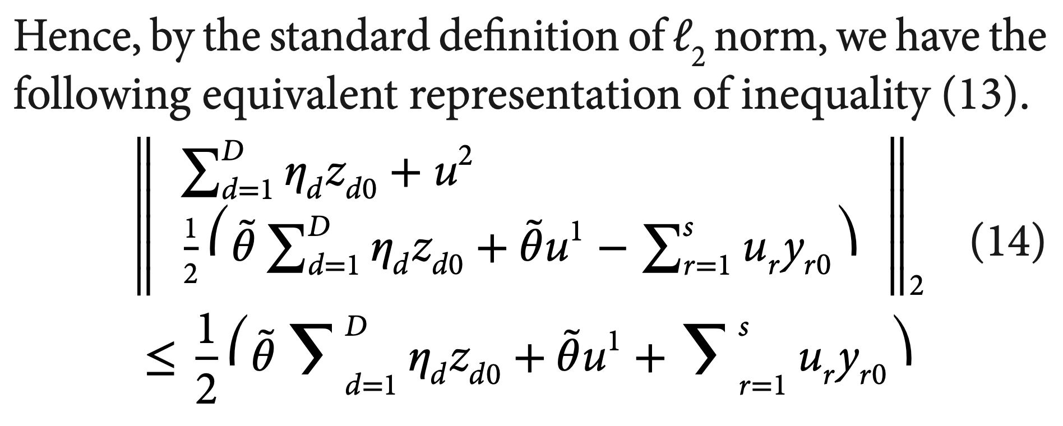
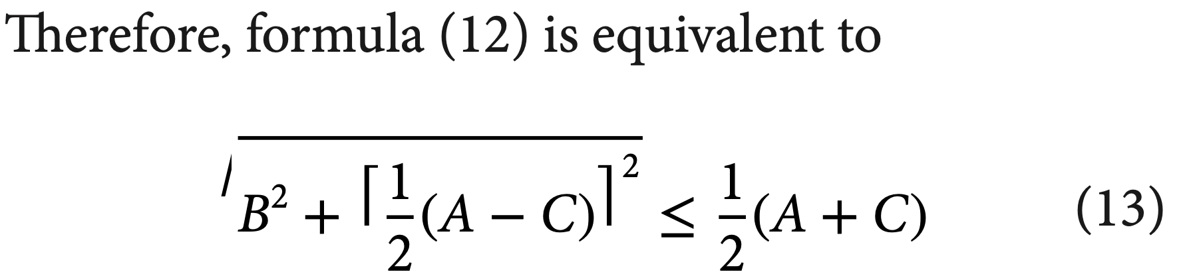
Scale efficiency in two-stage network DEA
where “≻ = 0” means the matrix on the left is positive semi-definite since all terms in the matrix are positive.

Slide 12
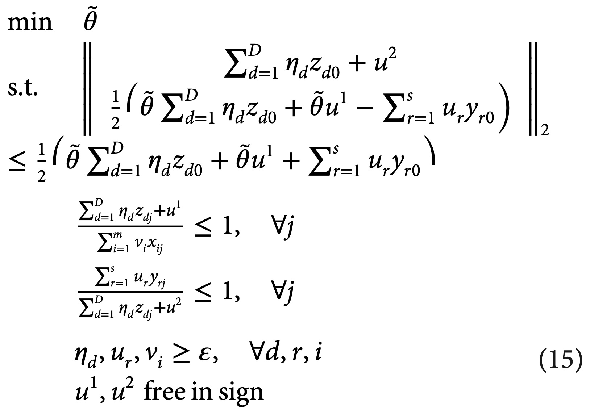
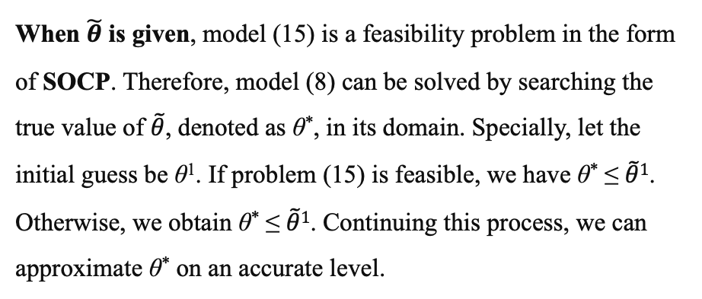
Scale efficiency in two-stage network DEA
When $\tilde{θ}$ is given, model (15) is a feasibility problem in the form of SOCP. Therefore, model (8) can be solved by searching the true value of $\tilde{θ}$, denoted as θ*, in its domain. Specially, let the initial guess be θ¹. If problem (15) is feasible, we have θ* ≤ $\tilde{θ}1$. Otherwise, we obtain θ* ≤ $\tilde{θ}1$. Continuing this process, we can approximate θ* on an accurate level.

Slide 13
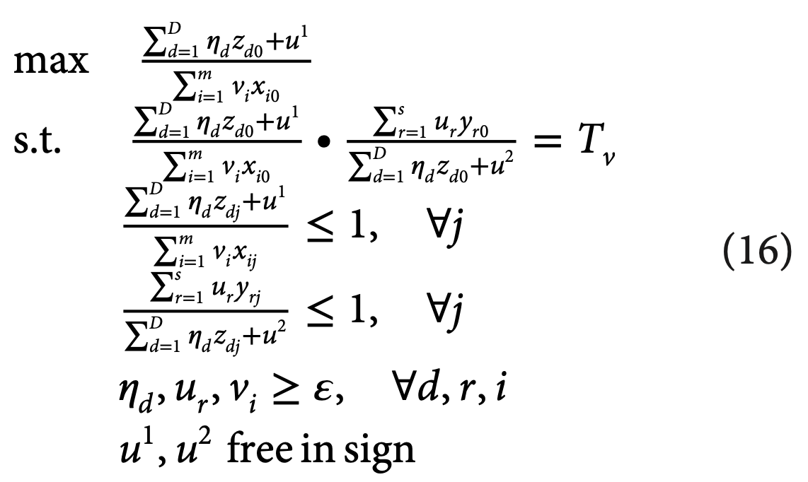
Scale efficiency in two-stage network DEA
Suppose the optimal objective value of model (8) is denoted as T_{v}. To ensure unique divisional technical efficiency, we propose the following model by fixing the value of T_{v}. For simplicity, we only consider the case of maximizing the efficiency of first stage.

Slide 14
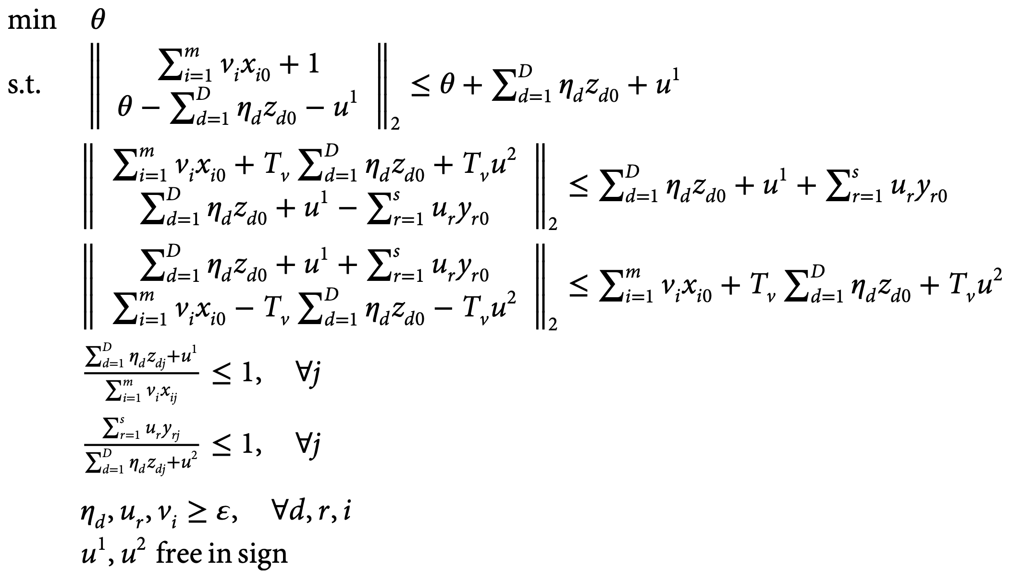
Scale efficiency in two-stage network DEA

Slide 15
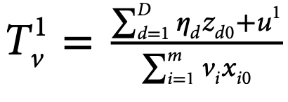
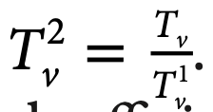
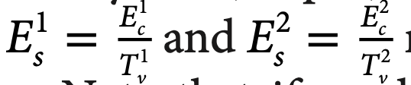
Scale efficiency in two-stage network DEA
Note that if model (16) and its alternative model which is maximizing technical efficiency of the second stage yield different decompositions of overall technical efficiency, there will be multiple divisional scale efficiency with respect to a single stage in network DEA. Thus, unlike the scale efficiency in the conventional DEA, network scale efficiency for each stage may not be unique.

Slide 16
現行問題
Scale efficiency in two-stage network DEA
Efficiency decomposition of the network DEA in variable returns to scale: an additive dissection in losses
Revised model

Slide 17
Efficiency decomposition of the network DEA in variable returns to scale: an additive dissection in losses
We define the loss of a process or system to be their cost (the aggregated input) minus their revenue (the aggregated output) and the profit is the revenue minus cost. A DMU is efficient if its loss is zero.

Slide 18
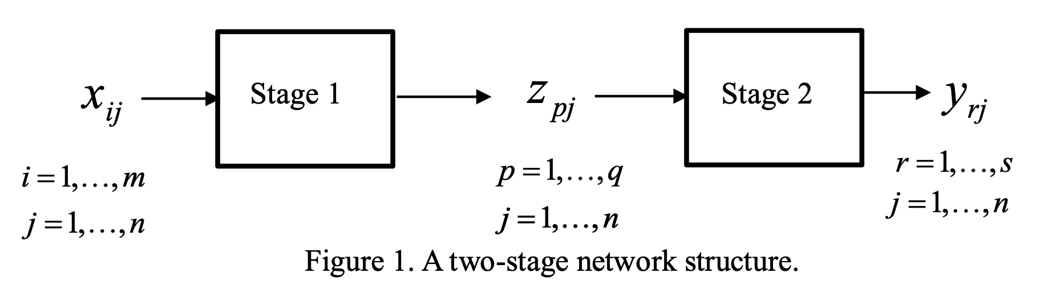
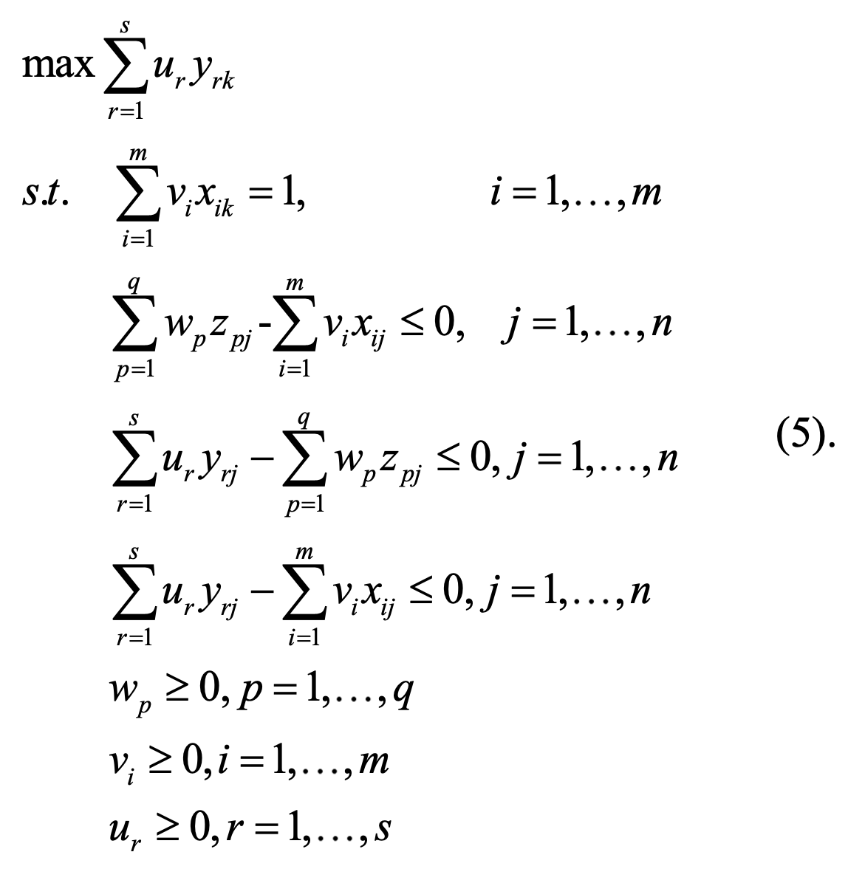
Efficiency decomposition of the network DEA in variable returns to scale: an additive dissection in losses
CRS

Slide 19
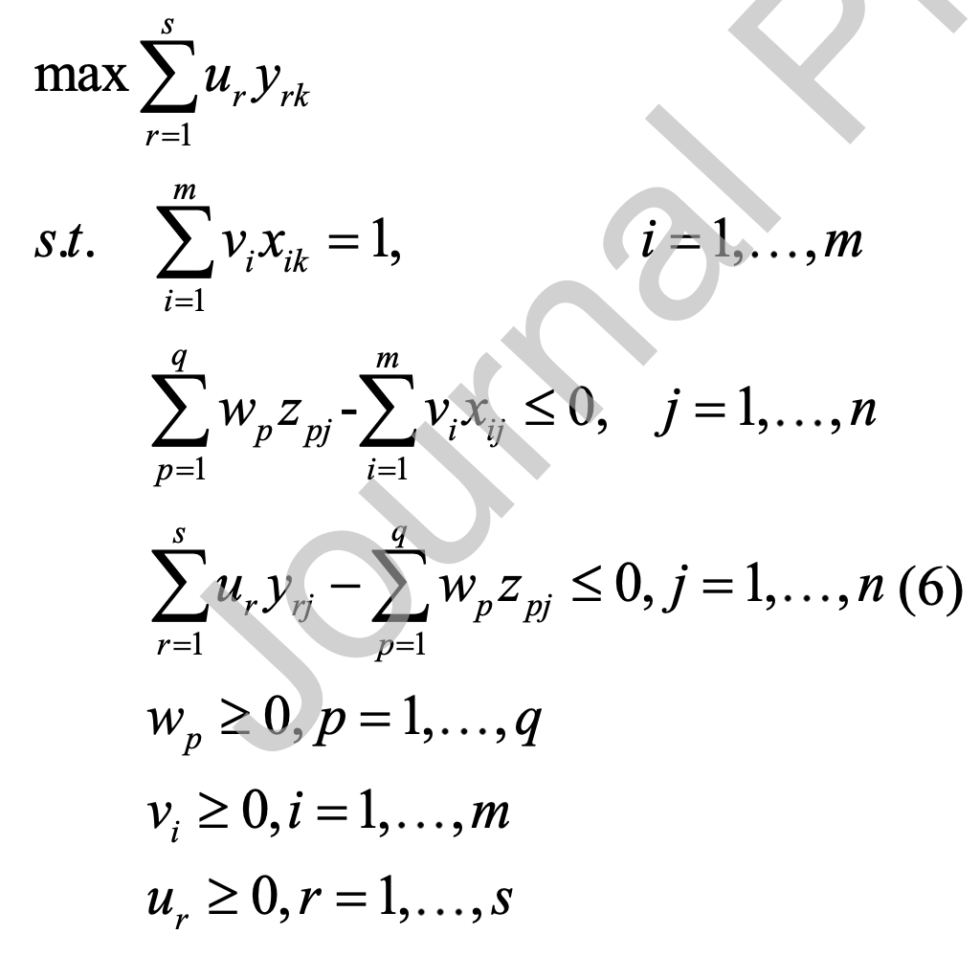
Efficiency decomposition of the network DEA in variable returns to scale: an additive dissection in losses
CRS
redundant

Slide 20
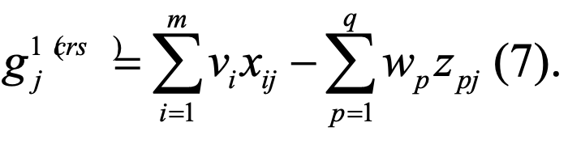
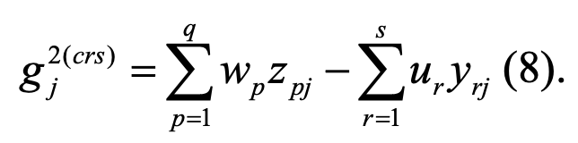
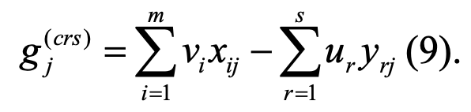
Efficiency decomposition of the network DEA in variable returns to scale: an additive dissection in losses
CRS
Let the loss of the DMU j at stage 1 under CRS be
cost (the aggregated input) minus
revenue (the aggregated output)
Let the loss of the DMU j at stage 2 under CRS be
Let the system loss of the DMU j under CRS be
If the loss is zero, the DMU is efficient.
The larger the loss, the lower the efficiency.

Slide 21
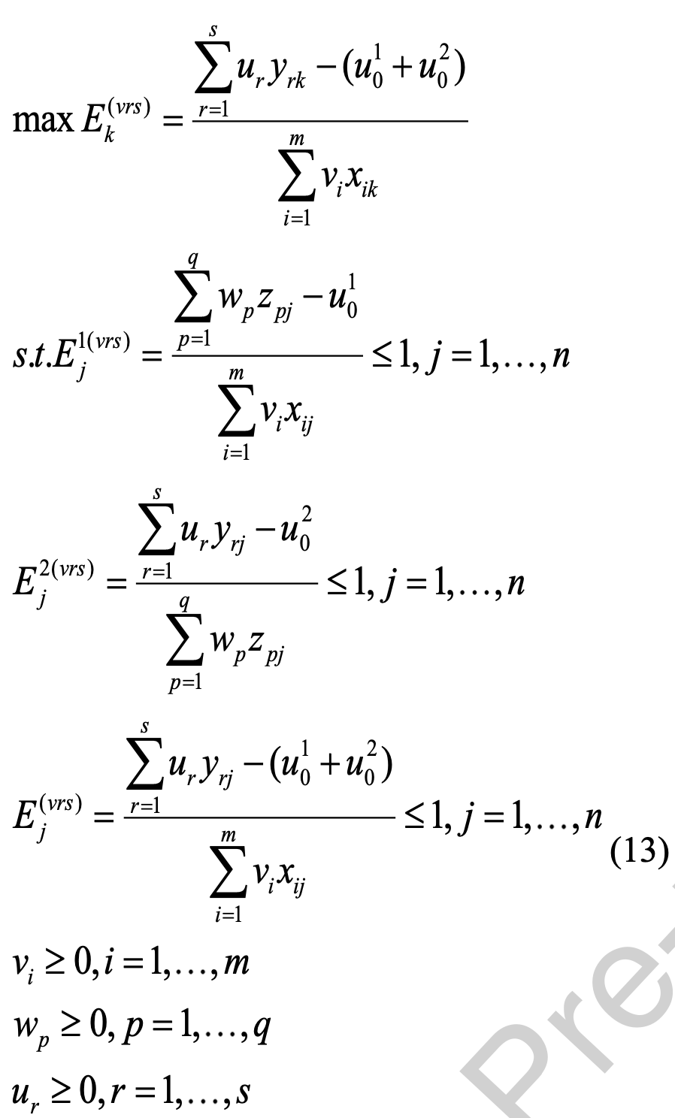
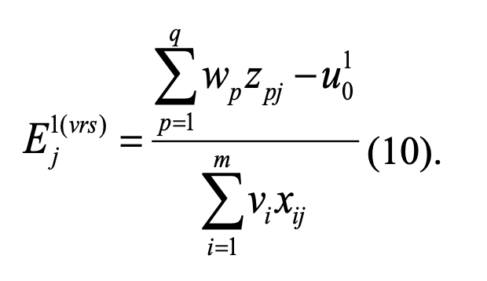
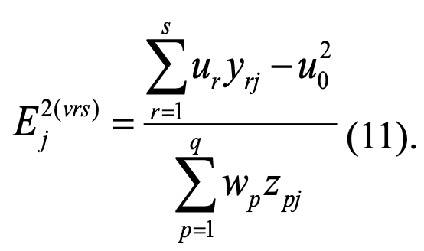
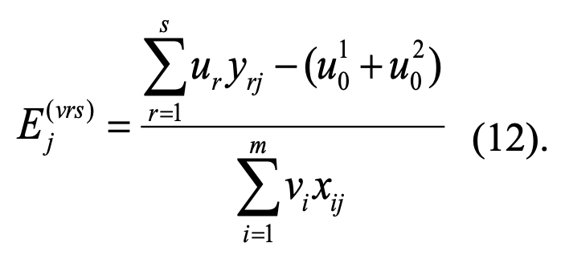
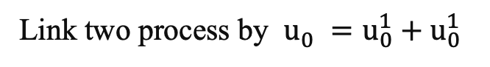
Efficiency decomposition of the network DEA in variable returns to scale: an additive dissection in losses
VRS
Link two process by $u_{0}^{}=u_{0}^{1}+u_{0}^{1}$

Slide 22
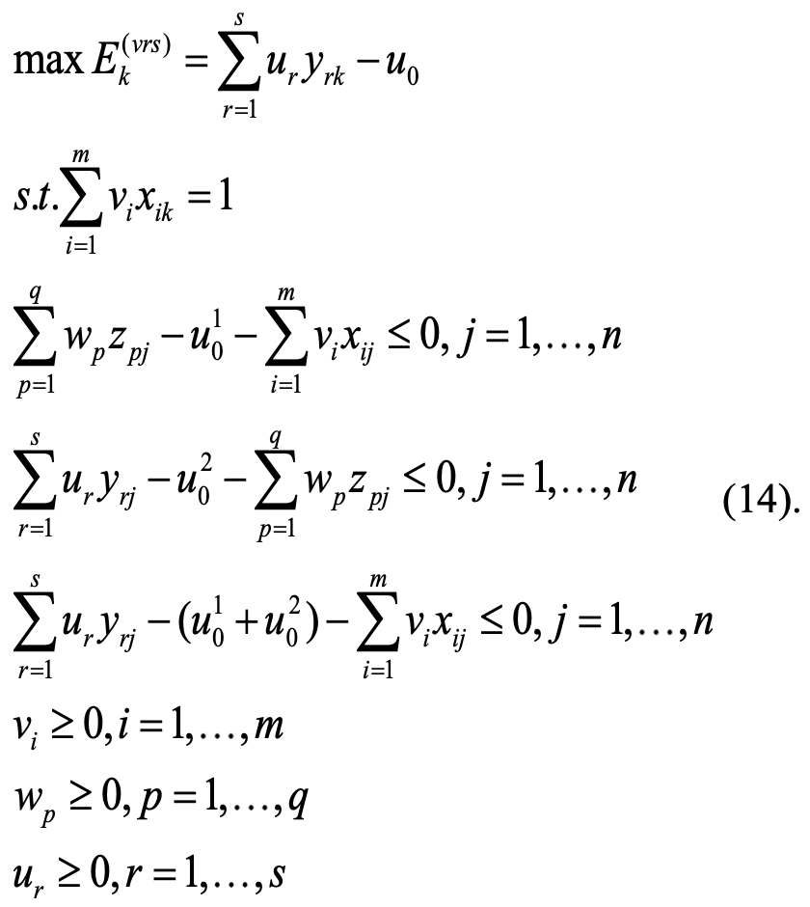
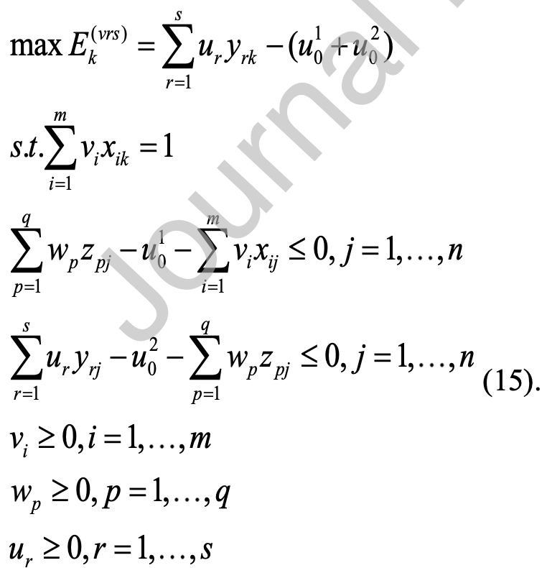
Efficiency decomposition of the network DEA in variable returns to scale: an additive dissection in losses
VRS

Slide 23
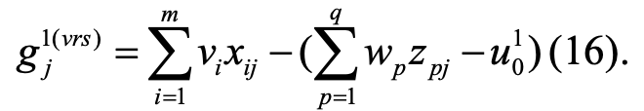
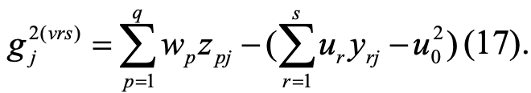
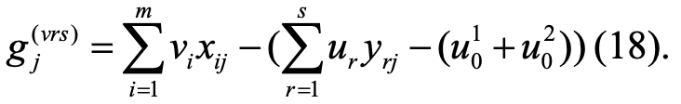
Efficiency decomposition of the network DEA in variable returns to scale: an additive dissection in losses
VRS
Let the loss of the DMU j at stage 1 under CRS be
Let the loss of the DMU j at stage 2 under CRS be
Let the system loss of the DMU j under CRS be

Slide 24


Efficiency decomposition of the network DEA in variable returns to scale: an additive dissection in losses
CRS
VRS

Slide 25



Efficiency decomposition of the network DEA in variable returns to scale: an additive dissection in losses
Proof:

Slide 26



Efficiency decomposition of the network DEA in variable returns to scale: an additive dissection in losses
General network structure:(VRS)
intermediate outputs from process d' to process d
external inputs
external outputs
The loss for DMU j in process d is
The system loss for DMU j is

Slide 27


Efficiency decomposition of the network DEA in variable returns to scale: an additive dissection in losses
General network structure:(VRS)

Slide 28

Efficiency decomposition of the network DEA in variable returns to scale: an additive dissection in losses
General network structure:(VRS)

Slide 29

Efficiency decomposition of the network DEA in variable returns to scale: an additive dissection in losses
General network structure:(hybrid)

Slide 30


Efficiency decomposition of the network DEA in variable returns to scale: an additive dissection in losses
General network structure:(hybrid)

Slide 31
現行問題
Scale efficiency in two-stage network DEA
Efficiency decomposition of the network DEA in variable returns to scale: an additive dissection in losses
Revised model

Slide 32













$$X1$$
$$P1$$
$$Y1$$
$$Z^{1,3}$$
$$X21$$
$$Z^{1,2}$$
$$P3$$
$$X2$$
$$P2$$
$$Z^{2,3}$$
$$Y2$$
$$X22$$
Revised model
Network DEA in Insurance Industry

Slide 33






Revised model
Network DEA in Insurance Industry
$$Max$$
$s.t.$
$$u1Y_{k}^{1}+u2Y_{k}^{2}Y2k−u_{0}^{1}−u_{0}^{2}$$
$$v1X_{k}^{1}+v2X_{k}^{2}=1$$
$$v1, v2, w11, w12, w2,u1, u2$$
$X1, X2, Z1, Z2, Y1, Y2$ 的權重
$$\left(w^{1,3}{Z_{k}^{1,3}Z}^{1,3}Z11j+w12Z12j−w_{0}^{1}\right)−\left(v1X1j+v2X21j\right)≤0 j=1,…,n$$
$$w2Z2j−w_{0}^{2}−\left(v2X22j+w11Z11j−w_{0}^{1}\right)≤0 j=1,…,n$$
$$w_{0}^{1},w_{0}^{2}, u0$$
Multiplier variables
$$\left(u1Y1j+u2Y2j−u0\right)−\left(w12Z12j−w_{0}^{1}+w2Z2j−w_{0}^{2}\right)≤0 j=1,…,n$$
$$v1, v2, w1, w2, u1, u2≥ε$$

Slide 35


















Revised network DEA model
Network DEA in Insurance Industry
(VRS input-oriented)
Notations:
$X1$: Insurance expenses
$X2$: Operation expenses
$X21$: 50% of $X2$
$X22$: 50% of $X2$
$Z1$: Premium income
$Z11$: Premiums ceded to reinsurers
$Z12$: $Z1−Z11$
$Z2$: Reinsurance premiums
$P1$: Direct insurance
$P2$: Reinsurance
$P3$: Profit generation
$Y1$: Underwriting profit
$Y2$: Investment profit
$$X1$$
$$P1$$
$$Z1$$
$$Y1$$
$$Z12$$
$$X21$$
$$P3$$
$$Z11$$
$$X2$$
$$P2$$
$$Z2$$
$$Y2$$
$$X22$$

